Slide 1
Object Oriented Programming ICT-1203
Dr. Jesmin Akhter
Associate Professor, IIT, JU

Slide 2
Multithreaded Programming-2

Slide 3
Thread Scheduler in Java
Thread scheduler in java is the part of the JVM that decides which thread should run.
There is no guarantee that which runnable thread will be chosen to run by the thread scheduler.
Only one thread at a time can run in a single process.
The thread scheduler mainly uses preemptive or time slicing scheduling to schedule the threads.

Slide 4
Sleep method in java
The sleep() method of Thread class is used to sleep a thread for the specified amount of time.
Syntax of sleep() method in java
The Thread class provides a method for sleeping a thread:
public static void sleep(long miliseconds)throws InterruptedException

Slide 5
Example of sleep method in java
class TestSleepMethod1 extends Thread{
public void run(){
for(int i=1;i<5;i++){
try{Thread.sleep(500);}catch(InterruptedException e){System.out.println(e);}
System.out.println(i);
}
}
public static void main(String args[]){
TestSleepMethod1 t1=new TestSleepMethod1();
TestSleepMethod1 t2=new TestSleepMethod1();
t1.start();
t2.start();
}
}
Output:
1
1
2
2
3
3
4
4
As you know well that at a time only one thread is executed. If you sleep a thread for the specified time, the thread scheduler picks up another thread and so on.

Slide 6
Can we start a thread twice
No. After starting a thread, it can never be started again. If you does so, an IllegalThreadStateException is thrown. In such case, thread will run once but for second time, it will throw exception.
public class TestThreadTwice1 extends Thread{
public void run(){
System.out.println("running...");
}
public static void main(String args[]){
TestThreadTwice1 t1=new TestThreadTwice1();
t1.start();
t1.start();
}
}
Output:
running
Exception in thread "main" java.lang.IllegalThreadStateException

Slide 7
What if we call run() method directly instead start() method?
The start method makes sure the code runs in a new thread context. If you called run directly, then it would be like an ordinary method call and it would run in the context of the current thread instead of the new one. The start method contains the special code to trigger the new thread; run obviously doesn't have that ability because you didn't include it when you wrote the run method.

Slide 8

Problem if you direct call run() method
class TestCallRun2 extends Thread{
public void run(){
for(int i=1;i<=5;i++){
try{Thread.sleep(500);}catch(InterruptedException e){System.out.println(e);}
System.out.println(i);
}
}
public static void main(String args[]){
TestCallRun2 t1=new TestCallRun2();
TestCallRun2 t2=new TestCallRun2();
t1.run();
t2.run();
}
}
As you can see in the above program that there is no context-switching because here t1 and t2 will be treated as normal object not thread object.

Slide 9
The join() method
The join() method waits for a thread to die. In other words, it causes the currently running threads to stop executing until the thread it joins with completes its task.
Syntax:
public void join()throws InterruptedException
public void join(long milliseconds)throws InterruptedException
Example of join(long miliseconds) method (Next slide)

Slide 10

class TestJoinMethod2 extends Thread{
public void run(){
for(int i=1;i<=5;i++){
try{
Thread.sleep(500);
}catch(Exception e){System.out.println(e);}
System.out.println(i);
}
}
public static void main(String args[]){
TestJoinMethod2 t1=new TestJoinMethod2();
TestJoinMethod2 t2=new TestJoinMethod2();
TestJoinMethod2 t3=new TestJoinMethod2();
t1.start();
try{
t1.join(1500);
}catch(Exception e){System.out.println(e);}
t2.start();
t3.start();
}
}
In the above example, when t1 is completes its task for 1500 miliseconds(3 times) then t2 and t3 starts executing.

Slide 11
getName(),setName(String) and getId() method:
public String getName()
public void setName(String name)
public long getId()

Slide 12
class TestJoinMethod3 extends Thread{
public void run(){
System.out.println("running...");
}
public static void main(String args[]){
TestJoinMethod3 t1=new TestJoinMethod3();
TestJoinMethod3 t2=new TestJoinMethod3();
System.out.println("Name of t1:"+t1.getName());
System.out.println("Name of t2:"+t2.getName());
System.out.println("id of t1:"+t1.getId());
t1.start();
t1.setName(“ICT");
System.out.println("After changing name of t1:"+t1.getName());
t2.start();
}
}
Output:
Name of t1:Thread-0
Name of t2:Thread-1
id of t1:8
running...
After changling name of t1: ICT
running...

Slide 13
Multithreaded Programming-3

Slide 14
Thread Priorities
Thread priorities are used by the thread scheduler to decide when each thread should be allowed to run.
In theory, higher-priority threads get more CPU time than lower-priority threads.
A higher-priority thread can also preempt a lower-priority one. For instance, when a lower-priority thread is running and a higher-priority thread resumes (from sleeping or waiting on I/O, for example), it will preempt the lower-priority thread.

Slide 15
To set a thread’s priority, use the setPriority( ) method, which is a member of Thread. This is its general form:
final void setPriority(int level)
Here, level specifies the new priority setting for the calling thread. The value of level must be within the range MIN_PRIORITY and MAX_PRIORITY. Currently, these values are 1 and 10, respectively.
To return a thread to default priority, specify NORM_PRIORITY, which is currently 5.

Slide 16
You can obtain the current priority setting by calling the getPriority( ) method of Thread, shown here:
final int getPriority( )
getPriority() method is used to get the priority of the thread.

Slide 17
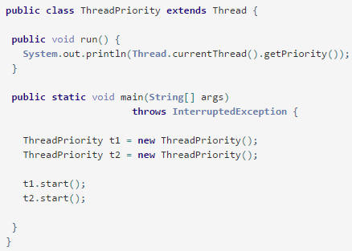
Example 1 : Default Thread Priority

Slide 18
Output of previous program:
5
5
Default priority of the thread is 5.
Each thread has normal priority at the time of creation. We can change or modify the thread priority in the following example 2.

Slide 19
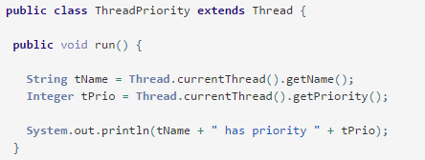
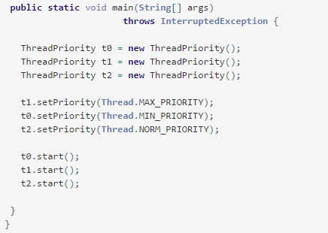
Example 2 : Setting Priority

Slide 20
Output of previous program:
Thread-0 has priority 1
Thread-2 has priority 5
Thread-1 has priority 10

Slide 21
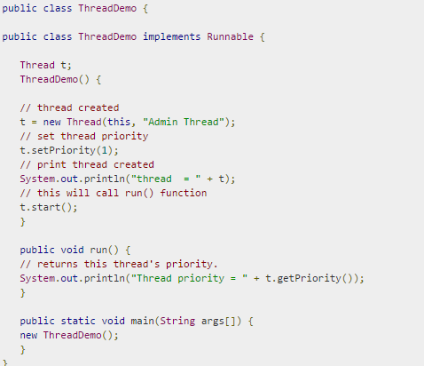

Slide 22
Output of previous program:
thread = Thread[Admin Thread,1,main] Thread priority = 1

Slide 23
Thank you

